Slide 1
Elim Senior Subject Options and Pathways
2022

Slide 2
Mathematics

Slide 3
English
Oo

Slide 4
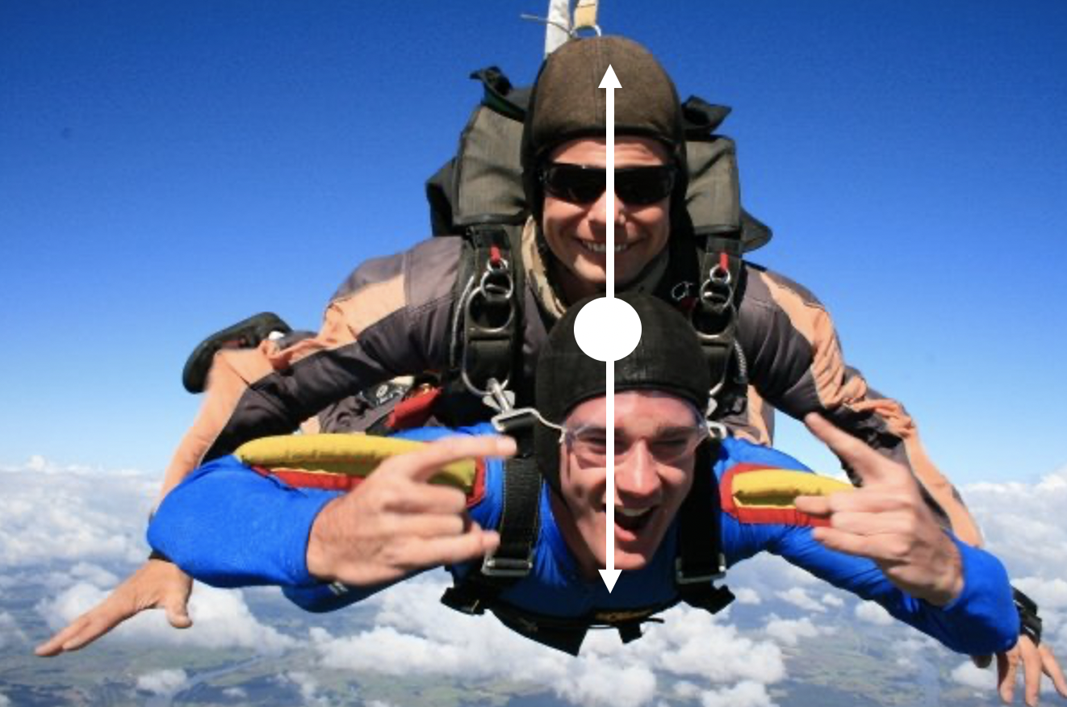
General Science (Yr 11 only)
Have you ever wondered how the universe and everything inside it operates with a desire to make a difference? Science will increase your curiosity and develop key skills required for the future. Learn more through our exciting general science program which offers a dynamic combination of biology, chemistry and physics learning both through practical and theory.
Students have the opportunity to specialize in these disciplines from year 12.

Slide 5
Biology
Have you ever wondered how your cells work, how you inherited the features that make you an individual and how perfectly God made everything to live in a certain niche?
In Level 2 Biology we learn about the intricate workings of the cell, how animals are adapted to living in their environments, inheritance and gene expression. You will also learn to identify BAD SCIENCE.
Level 3 Biology looks at controversial socio-scientific issues, genetic manipulations, and various aspects of plant and animal responses as well as ideas on Speciation and Evolution. This course aims to develop critical thinking and analysis of information.

Slide 6
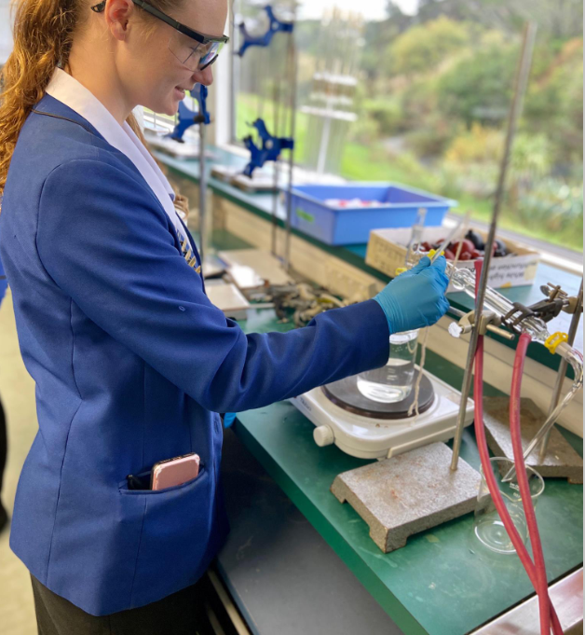
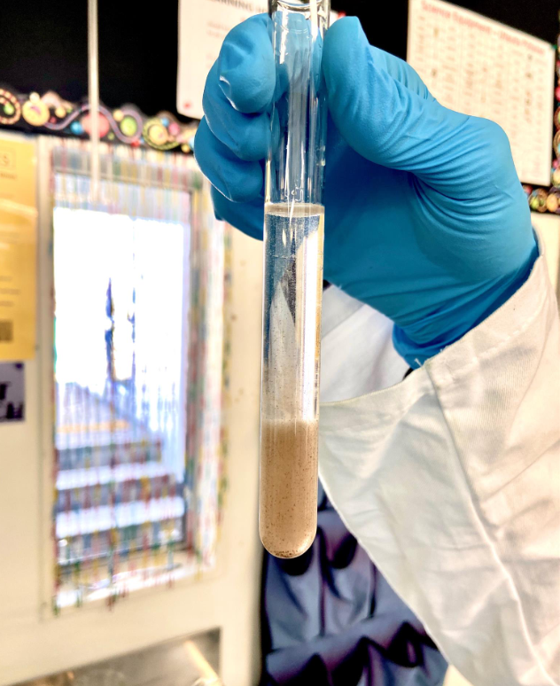
Chemistry
In level 2 and 3 we cover Organic Chemistry, and Inorganic Chemistry including Redox and Spectroscopy.
You will pick up core skills of communication, collaboration, critical thinking and curiosity which is needed for the future world of work.

Slide 7
Physics
In Level 2 and 3, we cover Mechanics, Waves, Electricity and Nuclear Physics. We also do a practical investigation.
If you want to understand what is going on in this video, take Physics!
Career pathways: Engineering, Sciences, life skills.

Slide 8
Geography

Slide 9
History

Slide 10
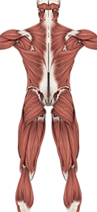
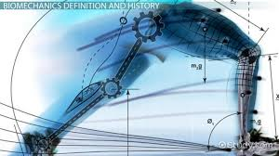
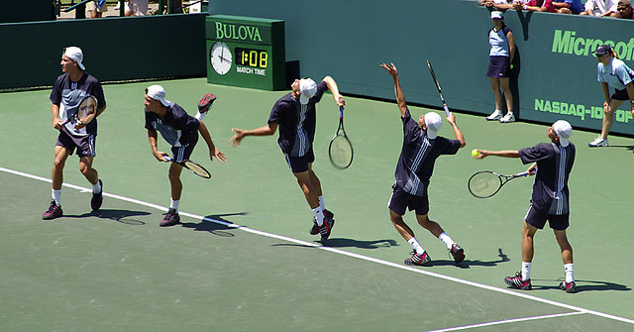
Physical Education PE
The PE option line at Level 1, 2 and 3 covers a range of different topics that are in applied in a range of sporting contexts. The subject area explores the body in motion, relationships with others, and the growth and development of an individual's haoura or wellbeing.
Anatomy
Biomechanics
Physiology
Sports Performance
Sport Skill Analysis
Interpersonal skills
Group Leadership

Slide 11
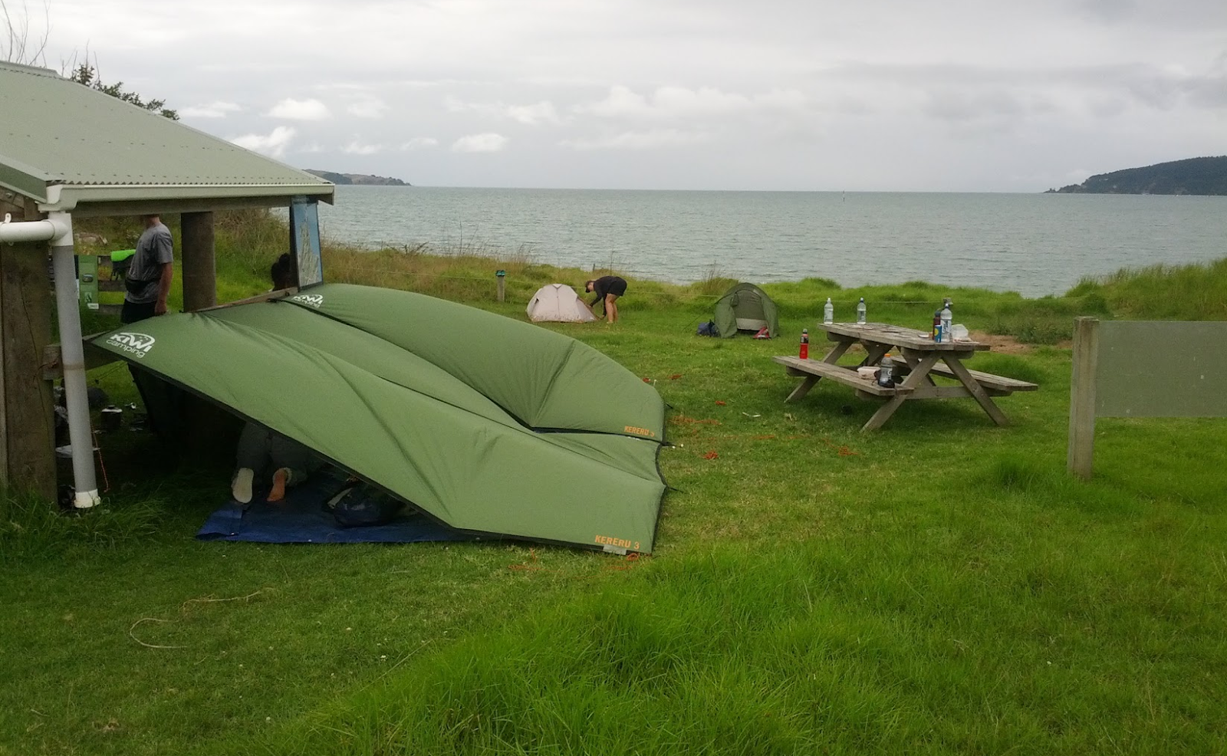
Outdoor Education OED
The Outdoor Education option at L2 and L3 develops students understanding, knowledge and awareness of outdoor pursuits while focusing on risk management, trip planning, social responsibility and character development.
Outdoor pursuits include
Tramping and Navigation
Indoor/outdoor rock climbing
Kayaking
Scuba diving
Sailing

Slide 12
The Visual Arts
The Visual Arts is a huge area of study aimed at all the creative industries. From Movie making to Architecture and Design to Fashion, having a visual art subject in your portfolio is just what they’ll be looking for.
You see its all about Creative thinking - can you see the fresh new idea amongst the obvious solutions? This is an asset in all industries.
The Visual Art subjects focus these skills and build on your God given talents to prepare you for the tertiary study or rounding out your year’s study.

Slide 13
The Visual Arts - Painting
Year 11 – Painting
A practical course for a diverse range of art activity. Developing core skills in: drawing, painting, design and printmaking.
Students also gain understanding of art works from New Zealand and Polynesian cultural context.
Year 12 / 13 – Painting
The course aims to provide a strong foundation for further study in Art at tertiary level.
Students pursue their own research and engage in a variety of practical works including analytical drawing from observation, developed sequences of compositional drawings, small works in colour media and finished paintings.
All years have external assessment by folio submission.

Slide 14
The Visual Arts
Year 11 – Digital Design Largely digital outcomes using Adobe CCS. From this course student can elect Design or Photography in Year 12. No external credits therefore not endorsed.
Year 12 / 13 – Design Preparation for tertiary study in design field. Brand & logo design Product / business promotional graphics.
External folio submission.

Slide 15
The Visual Arts - Photography
Year 12 / 13 – Photography
Learn the power of a DSLR Camera. This is a digital photography course focusing on the skill of Photography as Fine Art.
Both years have external portfolios
of highly finished artwork.

Slide 16
Art History

Slide 17
DVC – Design and Visual Communication

Slide 20
Digital Technologies bit.ly/dtatelim
OoThe The o
Digital Technology is an exciting, challenging, and growing field that impacts the world and everyday life in countless ways. Computer scientists are involved in creating technology and systems that are used in a wide range of industries, including medicine, communications, entertainment, manufacturing, business, and science. CS research pushes the state-of-the-art in computing theory and practice, and it leads to new technologies that change the world, such as the personal computer, the internet, cell phones, social media, and much more, as well as new discoveries in science and engineering, new possibilities for social science and the humanities, and creative collaborations with the arts.

Slide 21
Accounting
G
Accounting helps you understand financial information such as budgets, bank statements and financial statements used by businesses and clubs
It involves preparing financial records including using a spreadsheet
You learn to analyse and interpret what this financial information means
Accounting also helps you to make good financial decisions

Slide 22
Economics

Slide 23
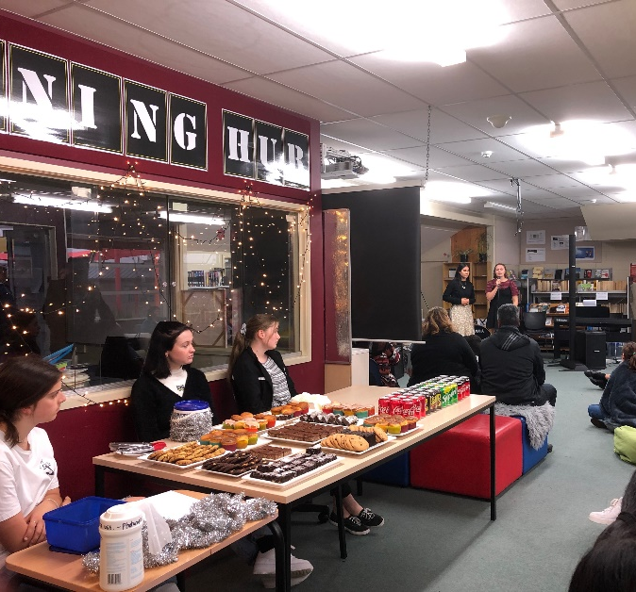
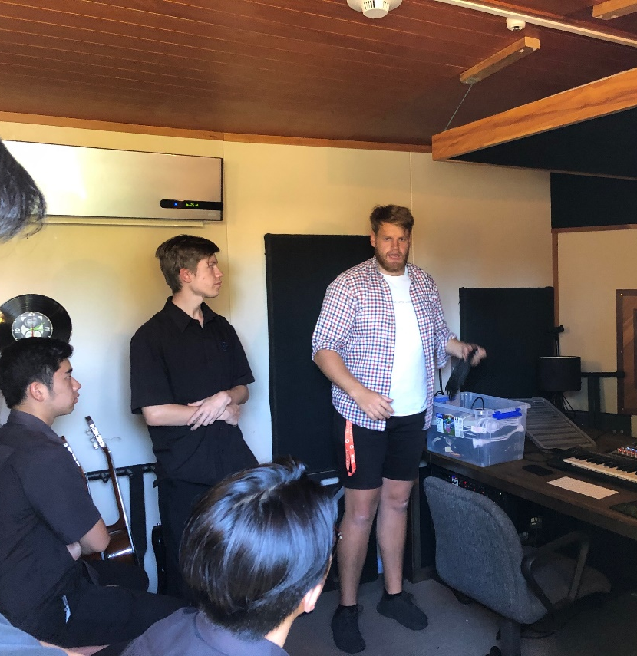
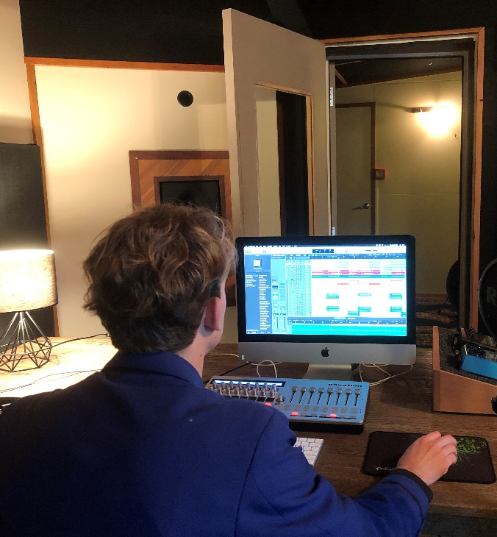
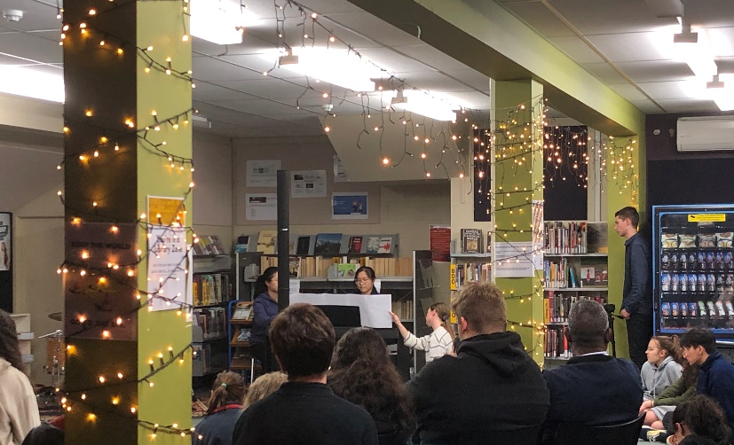
Music
Senior NCEA music is designed to cater for musicians who aim to develop a deeper understanding and appreciation of music and to discover musical potential. To further develop their performance skills, students need to be involved in instrumental or vocal lessons either privately or at school.

Slide 24
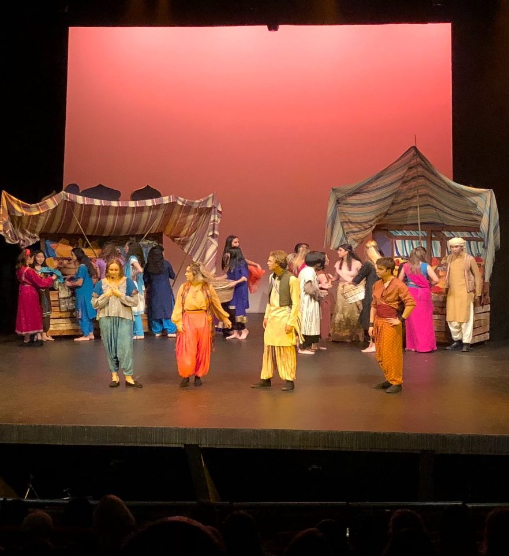
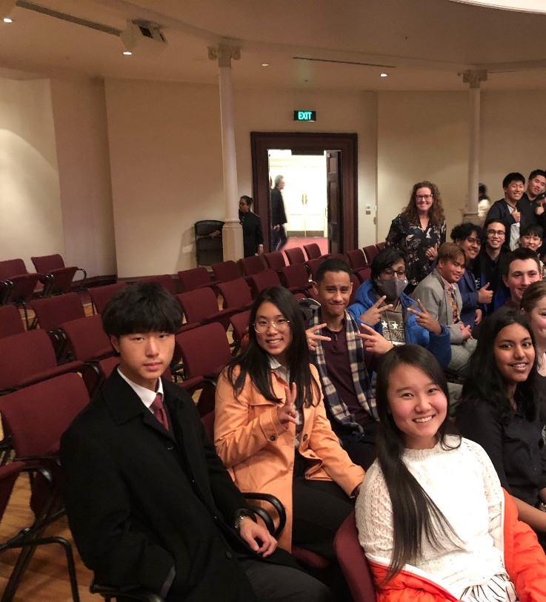
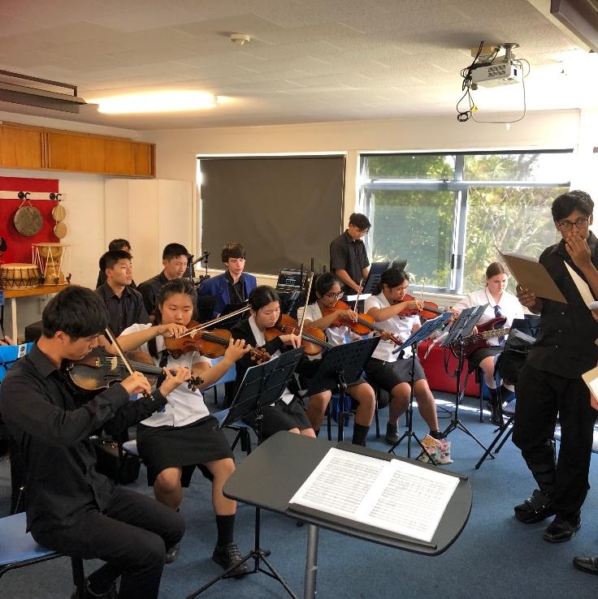
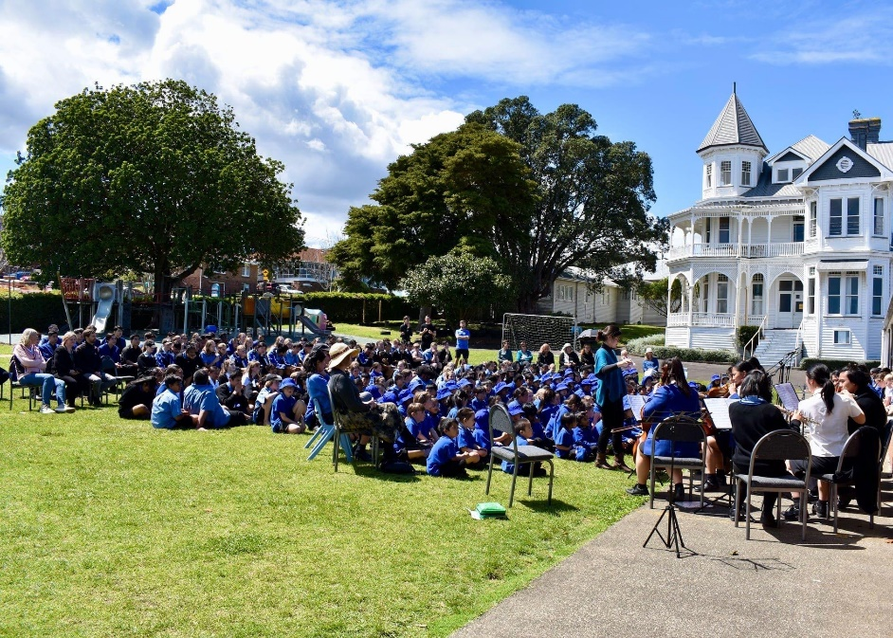
Music
Students have been given the opportunity to participate in lots of co-curricular music at school to broaden their musical experience and this may also count towards their performance credits Level 1-3
Music offers a wide variety of practical music making experiences. It is an ideal course for students wishing to head for further study or employment in music.

Slide 25
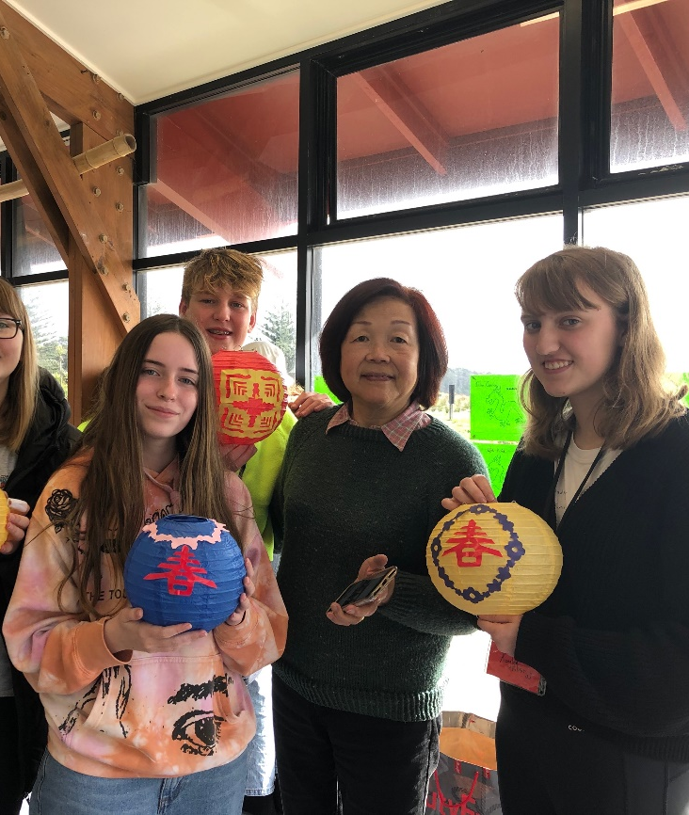
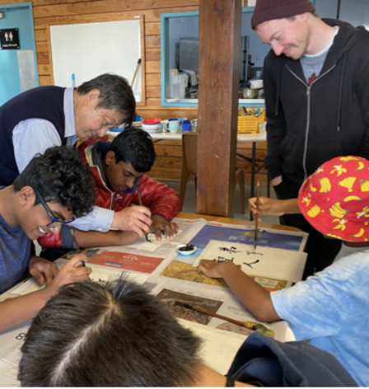
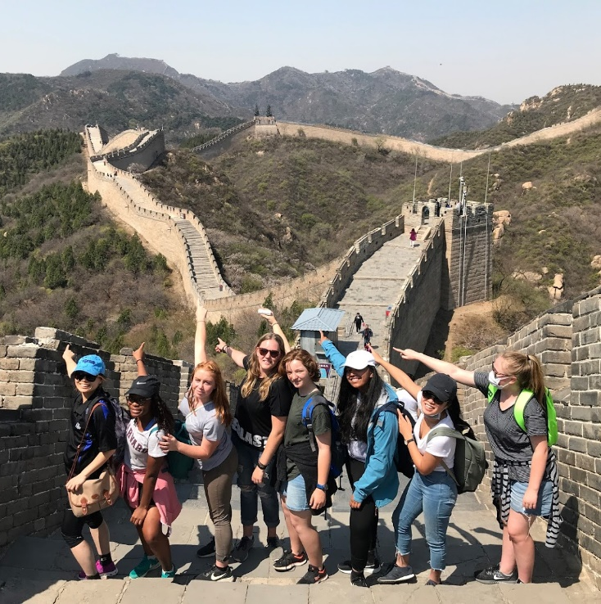
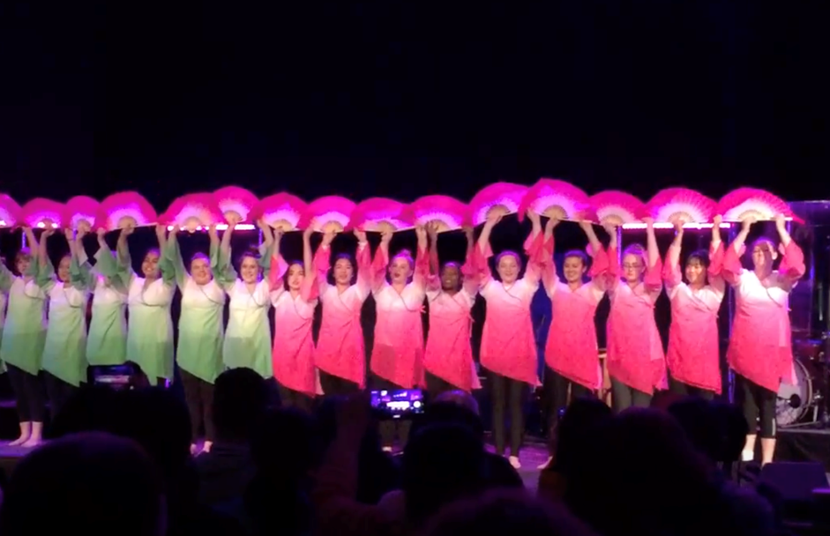
Chinese
Chinese is one of the most widely spoken languages in the world. The Chinese course is designed to provide in-depth understanding of the Chinese language and culture.
Students will have opportunities to consider and interpret the world from a culturally different point of view. Being an interactive course, students will acquire knowledge, skills and attitudes that will equip them for a world of diverse peoples, languages and cultures. Students will also reflect on their cultural identities and assumptions in this course.
Why you should take Chinese at year 10 and above?

Slide 26
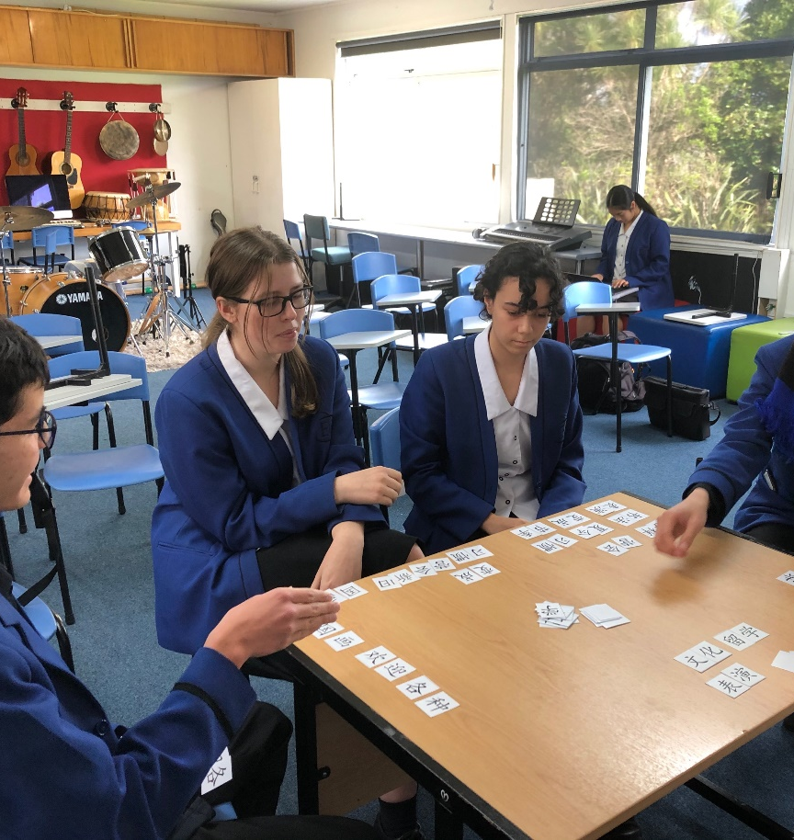
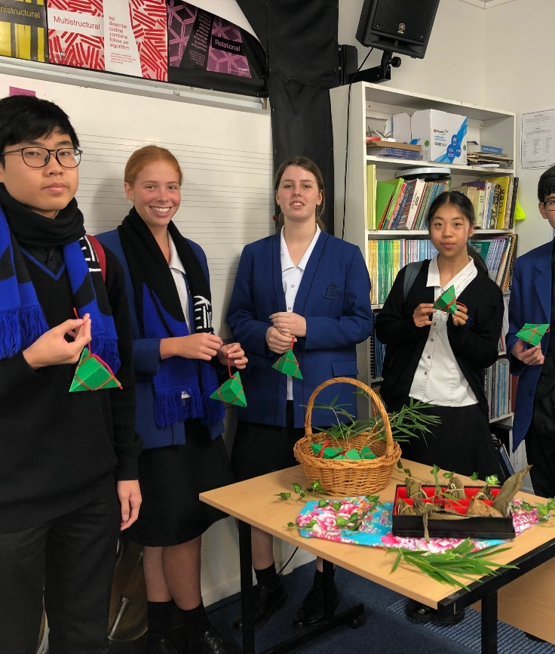
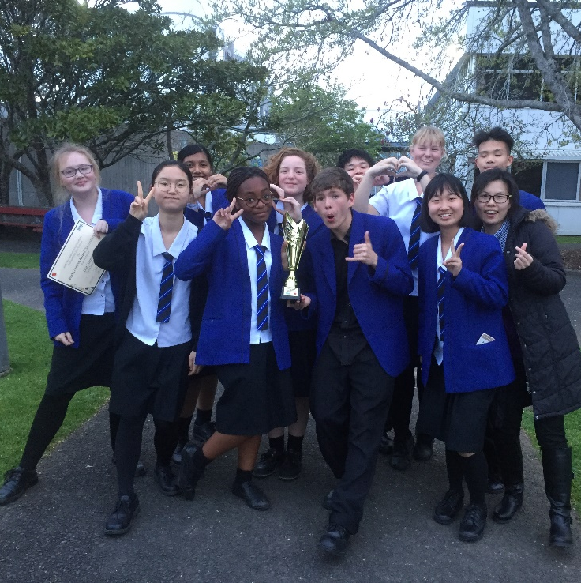
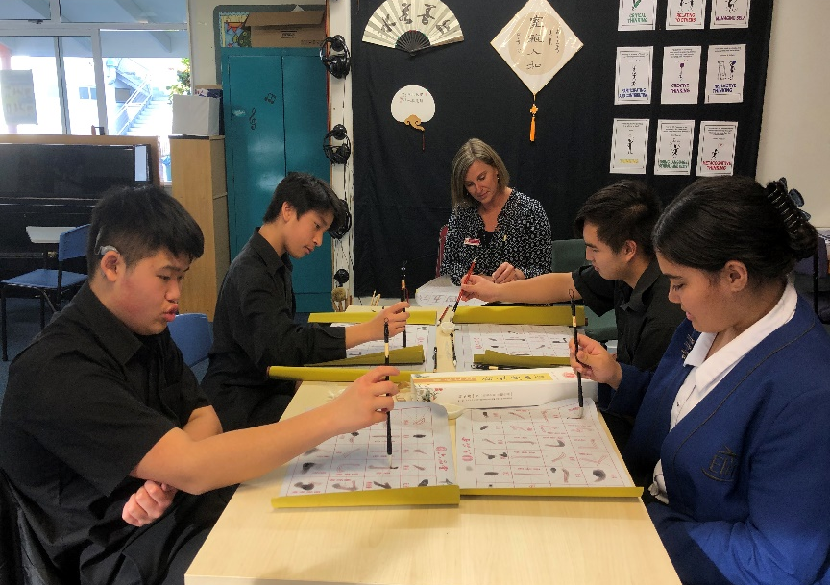
Chinese
NCEA Level 1 - Students will learn to understand and construct simple texts using their knowledge of the target language. Students will learn to describe aspects of their own background and immediate environment.
NCEA Level 2 - Students will learn to use language variably to express and justify their own ideas and opinions, and support or challenge those of others. They will learn to be able to use and identify the linguistic and cultural forms that guide interpretation and enable them to respond critically to texts. It is an ideal course for students wishing to head for further study or employment in Business.
NCEA Level 3 - Students will learn to use language variably and effectively to express and justify their own ideas and opinions, and support or challenge those of others. They will learn to be able to use and identify the linguistic and cultural forms that guide interpretation and enable them to respond critically to texts. It is an ideal course for students wishing to head for further study or employment in Business.

Slide 27
Christian Living
Luke 2:52 “And Jesus grew in wisdom and stature, and in favour with God and men.”
Christian Living is the exploration of what it means to live life as a Christian in the 21st century with a particular focus on teenage/youth issues. Being a Christian is not merely a matter of subscribing to a set of beliefs, it is about how those beliefs are lived out. Although the spiritual dimension of a person is often referred to as one aspect of life, as something separate, in Christian Living we subscribe more to the model that all aspects of life are spiritual and that the spiritual affects all aspects of life and living.
Christian Living includes exploring the beliefs a person holds (acknowledging their family and church backgrounds), the study of the Bible and of biblical concepts, and how this interacts with and impacts on the wholistic healthy development (Hauora) of the young person (socially, mentally, emotionally, physically and spiritually in the context of what is explained in paragraph 1). Christian Living is about application of their knowledge to real situations students face or will face in the tangible future. Students are challenged to make connections between the ideas explored in the classroom and the outworking of that in their families and the wider community.
Year 11s have Christian Living 2 periods a week.
Year 12s and 13s have Christian living 1 period a week.

