Slide 1
Year 11 2022
Choose your course by logging into the parent/ student portal and selecting “course selection” from the menu bar.
Choose your options and remember to save once your selection has been made.
You must choose your options by Friday, 24 September 2021.
Choose 5 subjects (one from each option line) which must include English, Mathematics and Science.
SUBJECT Level 1 | LINE 1 | LINE 2 | LINE 3 | LINE 4 | LINE 5
Accounting |  |  | 11ACC
Chinese | 11CHN
Design and Visual Communication |  | 11DVC
Digital Technologies |  |  |  |  | 11DT
Economics |  |  |  |  | 11ECO
English | 11ENG | 11ENG |  | 11ENG | 11ENG
English Alternative |  | 11ENGa
Geography | 11GEO
History |  | 11HIS
Mathematics | 11MAT | 11MAT | 11MAT
Mathematics Alternative |  |  | 11MATa
Music |  |  |  |  | 11MUS
Physical Education |  |  |  | 11PE
Science | 11SCI |  | 11SCI | 11SCI | 11SCI
Visual Arts (design) |  |  |  | 11ARTd
Visual Arts (painting) | 11ARTp
Level 2 Mathematics (prior approval required) | 12MAT | 12MAT | 12MAT | 12MAT
Correspondence: (subject to approval)
www.elim.school.nz

Slide 2
SUBJECT Level 2 | LINE 1 | LINE 2 | LINE 3 | LINE 4 | LINE 5
Accounting |  |  |  |  | 12ACC
Art History |  |  | 12ARH
Biology |  | 12BIO |  | 12BIO
Chemistry |  |  | 12CHE |  | 12CHE
Chinese |  | 12CHN
Design and Visual Communication |  |  |  | 12DVC
Digital Technologies | 12DT
Economics | 12ECO
English | 12ENG | 12ENG |  | 12ENG | 12ENG
English Alternative |  |  | 12ENGa |  | 12ENGa
Financial Literacy | 12FIN
Geography |  |  |  | 12GEO
History |  |  | 12HIS
Mathematics | 12MAT | 12MAT | 12MAT | 12MAT
Mathematics Alternative |  |  |  |  | 12MATa
Music |  |  |  | 12MUS
Outdoor Education | 12OED
Physical Education |  | 12PE
Physics | 12PHY |  | 12PHY
Travel and Tourism |  |  |  | 12TRV
Visual Arts (painting) | 12ARTp
Visual Arts (design) |  | 12ARTd
Visual Arts (photography) |  |  |  |  | 12ARTph
Additional Programmes: Gateway (L2) (Subject to approval)
Correspondence: (Subject to Approval)
Year 12 2022
Choose your course by logging into the parent/ student portal and selecting “course selection” from the menu bar.
Choose your options and remember to save once your selection has been made.
You must choose your options by Friday, 24 September 2021.
English is compulsory and mathematics is strongly recommended.
www.elim.school.nz

Slide 3
Year 13 2022
Choose your course by logging into the parent/ student portal and selecting “course selection” from the menu bar.
Choose your options and remember to save once your selection has been made.
You must choose your options by Friday, 24 September 2021.
Choose your course by selecting ONE subject in each column.
SUBJECT Level 3 | LINE 1 | LINE 2 | LINE 3 | LINE 4 | LINE 5
Accounting | 13ACC
Art History |  |  |  | 13ARH
Biology | 13BIO |  | 13BIO
Calculus |  |  | 13CAL |  | 13CAL
Chemistry | 13CHE | 13CHE
Chinese |  | 13CHN
Design and Visual Communication |  |  | 13DVC
Digital Technologies | 13DT
Economics |  |  |  | 13ECO
English | 13ENG |  | 13ENG | 13ENG
Financial Literacy |  |  |  | 13FIN
Geography |  | 13GEO
History | 13HIS |  |  |  | 13HIS
Music |  |  |  | 13MUS
Outdoor Education |  |  | 13OED
Physical Education |  |  |  |  | 13PE
Physics |  | 13PHY |  | 13PHY
Statistics |  | 13STA |  | 13STA | 13STA
Travel and Tourism |  |  |  | 13TRV
Visual Arts (painting) | 13ARTp
Visual Arts (design) |  | 13ARTd
Visual Arts (photography) |  |  |  |  | 13ARTph
Additional Programme: Gateway (L2, L3) (Subject to approval)
Correspondence: (Subject to Approval)
www.elim.school.nz

Slide 4
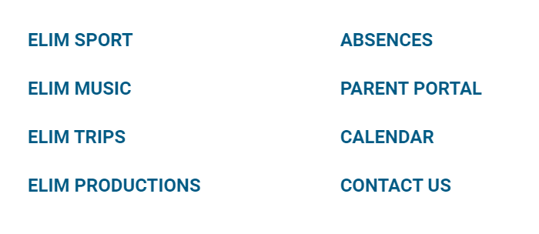
Using the portal to choose options
www.elim.school.nz

Slide 5
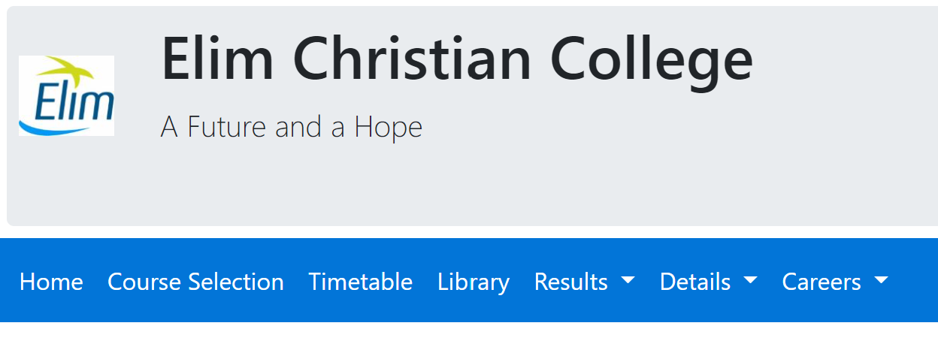
www.elim.school.nz

Slide 6
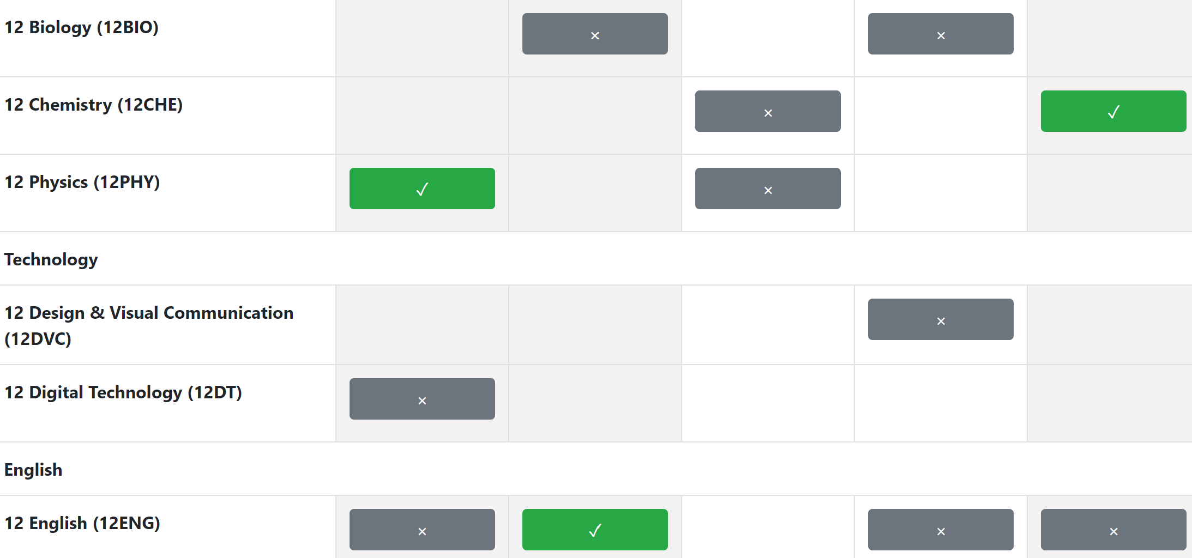
www.elim.school.nz

Slide 7
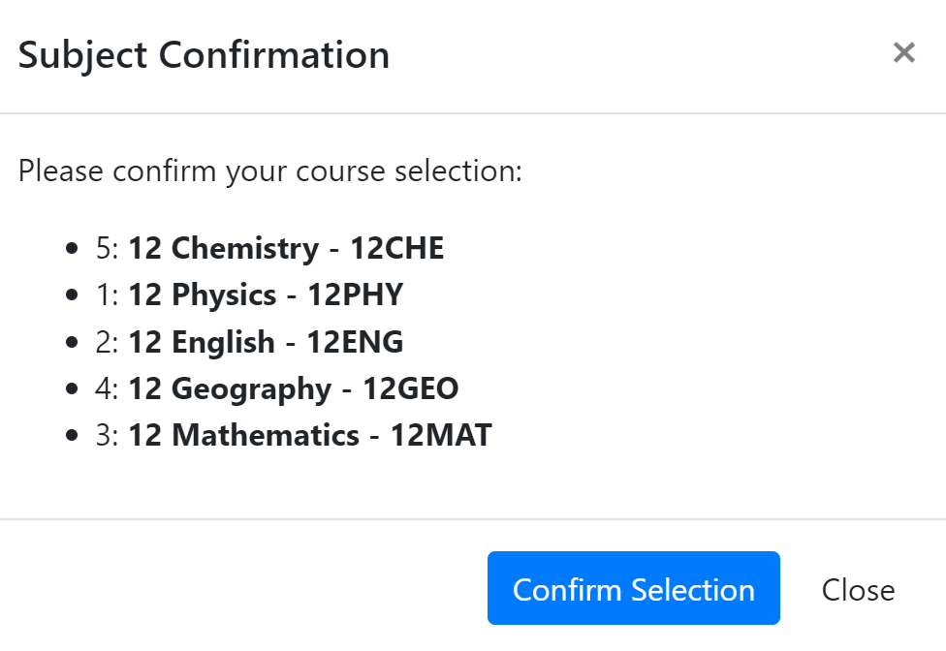
Before clicking save, you can preview your selected options
www.elim.school.nz

